Slide 1
https://dsmcfordcs.wordpress.com/

Slide 2
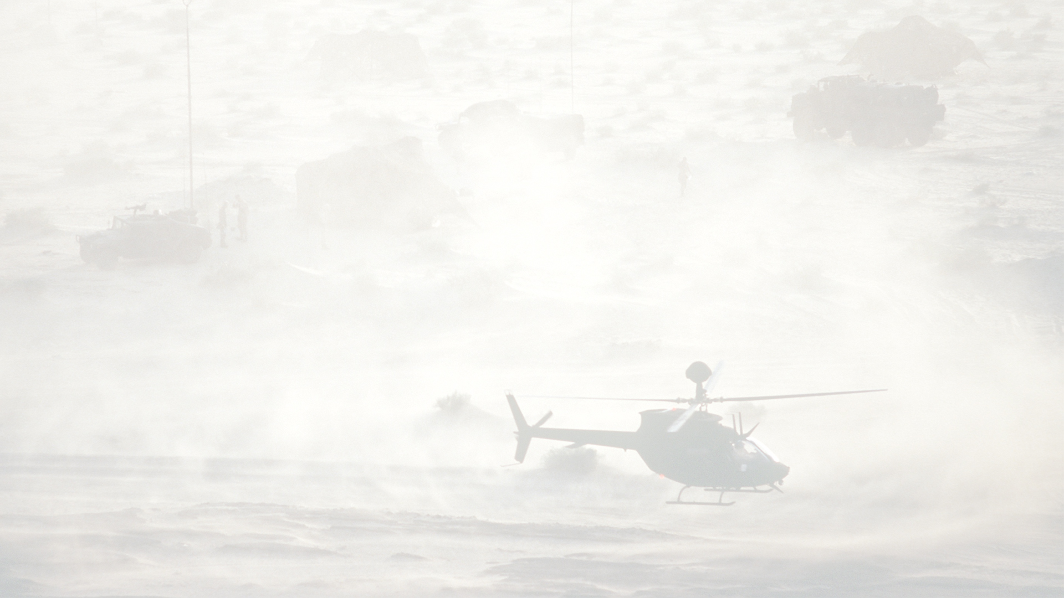
What is D.S.M.C. ?
DSMC is a mod for Digital Combat Simulator (DCS) done for mission designers and virtual squadrons willing to add persistency to their operations.
Once active, the mod enable the capability to «save» a mission while is running, creating a new .miz file, ready to be used, with updated content. The updated data will include, for examples:
Units positions and alive/dead state
Static & scenery object (like bridges, buildings...) dead state
Warehouse items (aircrafts, fuel quantity, items)
Conquered airbase/FARP
DSMC is designed to be compatible with MOOSE, mist & CTLD

Slide 3
What is D.S.M.C. ?
First thing, we don’t speak about «saving a mission» but instead to «save a scenario». That is cause DSMC can’t freeze the simulation and let you re-join later. It will create a new miz file that represent the scenery situation at the save moment: units, aircrafts, warehouse items, buildings.
This new miz file can be openen immediately or, instead, can be edited using the DCS mission editor. Since this tool is made for mission designers and server hosts, it also include a set of useful tools for server managers that will enable 24/7 persistent campaign operation.
Reading the manuals is NECESSARY to bring the best from this.

Slide 4
How to save a scenario ?
This is really easy, you only need to install the mod (see manual) and put the «DSMC» prefix on your mission file name.
Then, launch the mission and you will see an additional F10 menù option with a «save scenery» command. When you choose it, a save process will start: it could take seconds and it’s heavy to process, don’t do that while in action!
At the end of the save calculations a «scenery saved» message will appear and you will find the saved file in your \Saved Games\DCS.whatever\Missions\ folder.
DSMC provide an autosave function and a «save on last client disconnect» function for multiplayer servers, so that manual save can be disabled.

